Slide 1
Sales Analysis in Pakistan
Christos Andreopoulos – Antonis Zormpalas

Slide 2
Introduction
This presentation has been created for stakeholders and business decision makers within sales and business consulting services firm.

Slide 3
Methodology
Using a modified subset of the Kaggle dataset, the data was wrangled in order to remove empty values, manipulate specific data types , general data cleaning and data normalization.

Slide 4
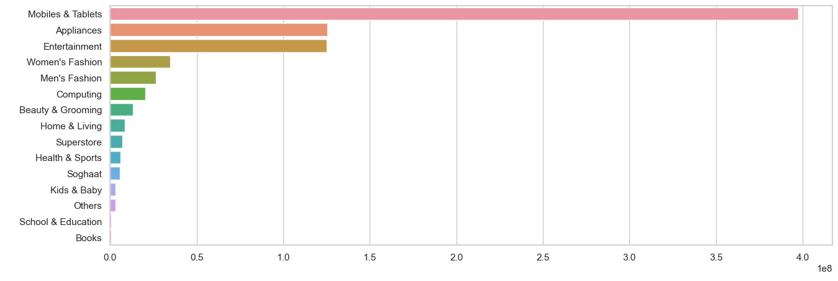
Best-Selling Category

Slide 5
Best-Selling Category(in millions) Findings and Implications
As we can see, mobile and tablet sales are significant higher(almost 4x) in comparison with the other categories.
Pakistan faces various challenges, including education, healthcare and infrastructure development.
Therefore, higher sales refer to digital gadgets, and the lowest, books and education.

Slide 6
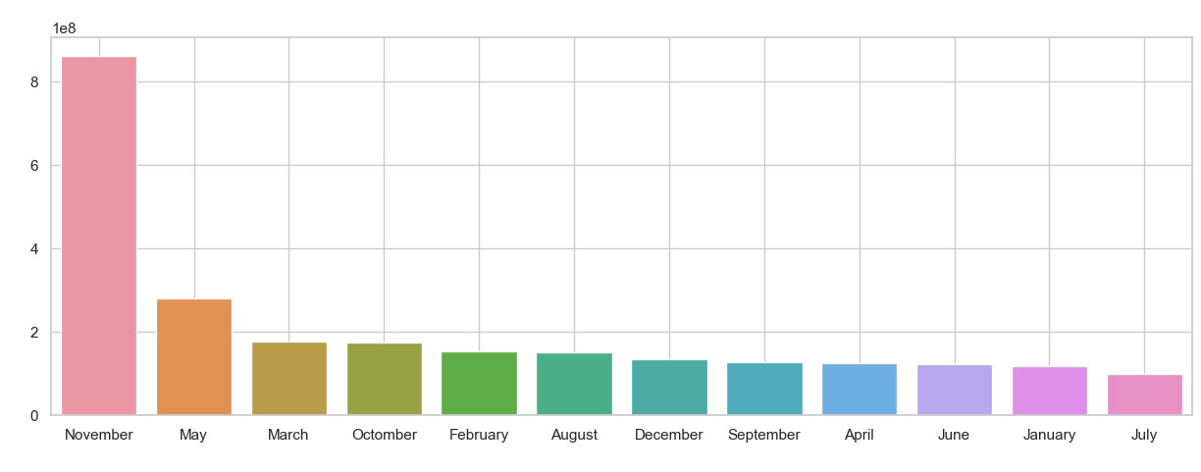
Sales per Month

Slide 7
Sales per Month Findings and Implications
In Pakistan, the month of November is followed by various festive occasions such as Eid al-Fitr and wedding seasons. During these times, people tend to do more shopping for clothes, gifts, and other items.

Slide 8
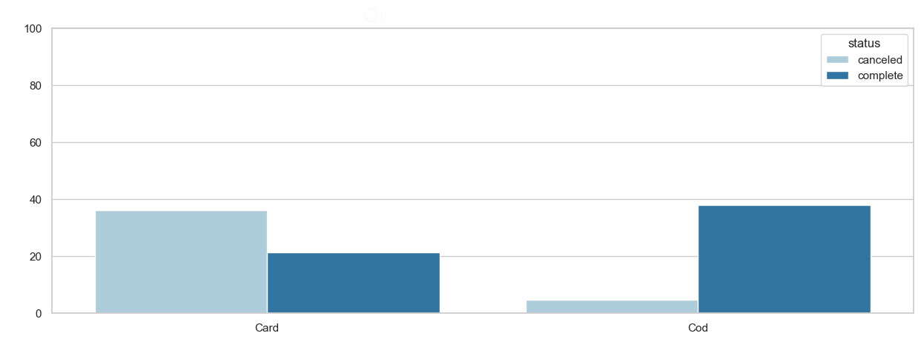
Order Status(percentages)

Slide 9
Sales per Month(in millions) Findings and Implications
Cod has significant better complete ratio than cards.

Slide 10
Conclusion
We could set a discount for customers buying with Cod (let’s say : for November), because as we see the majority of orders got completed.

